Slide 1

COVID-19 Throughout the United States
Chris LaLone
Capstone Project
3/20/21

Slide 2


Table of Contents
Data Collection
Variable Explanation
EDA
Regression Analysis
Variable Selection
Geographical Visualization
Take-aways/Conclusions
Sources

Slide 3
Data Collection Process and Research Questions
How did different parts of the U.S. react to the spread of the virus?
What are the major factors that contribute to the growth of the virus?
Can we pinpoint these factors down to the county level?
How can we use these findings to help prevent future pandemics?

Slide 4
Data Collection
COVID Data:
USAFacts.org COVID tracker
An excellent source for data down to the county level
Data collected is up to Feb. 20, 2021, but the sites are updated daily
Explanatory Variables:
American Community 5-year Survey for 2019
U.S. Census
National Bureau of Economic Research
Paper published June 2020, about a study of COVID factors on the county level

Slide 5
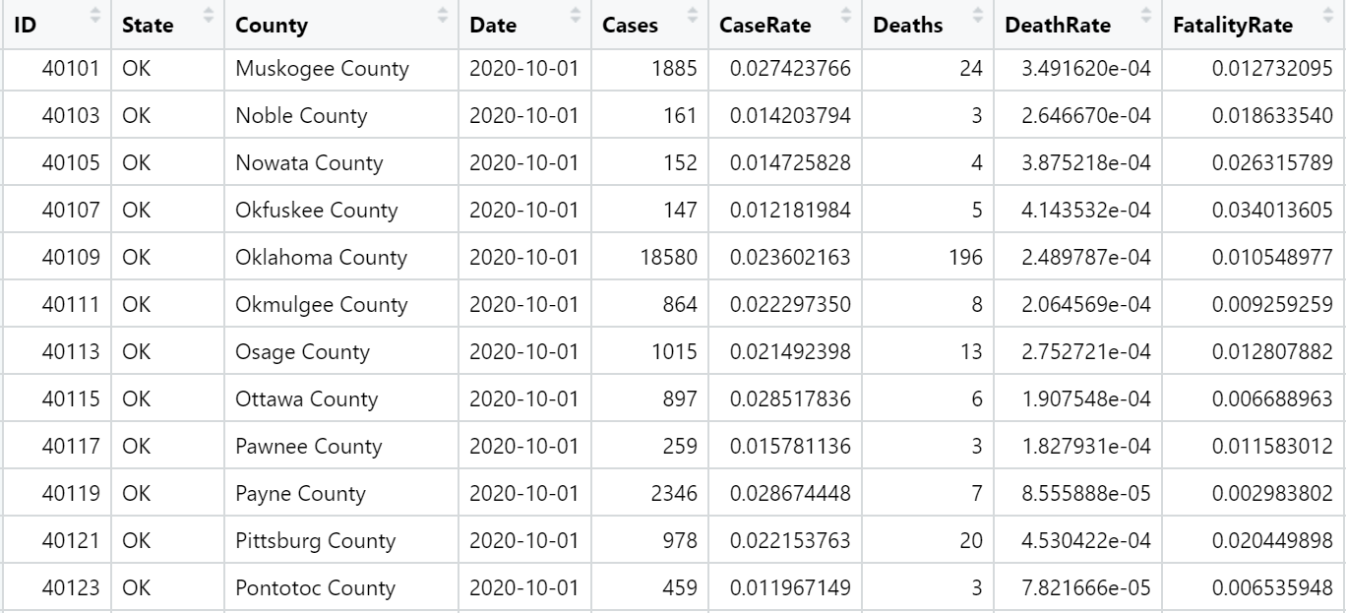
Data Collection
When sourcing data from many different sources, it isn’t always clean
Missing values were imputed with the mean if less than 30
Large percentage of the project was spent sourcing and cleaning data
For consistency, I converted variables to percentages of county population

Slide 6
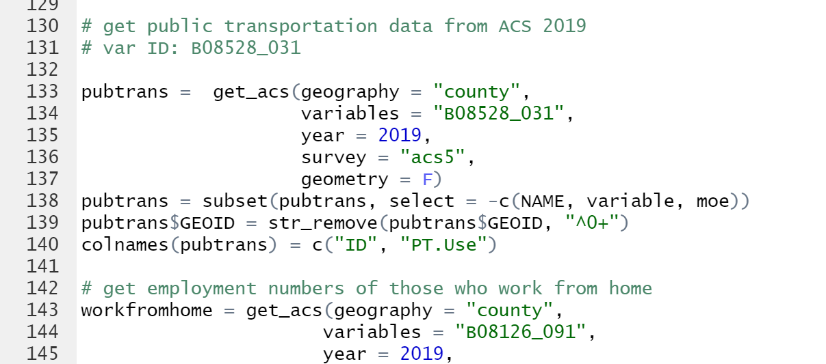
Data Collection
I specifically leaned heavily on the ACS and Census to gather a lot of the explanatory variables
The “tidycensus” library from the script: D04e_census.R that we used from class was incredibly helpful to source a wide range of variables

Slide 7
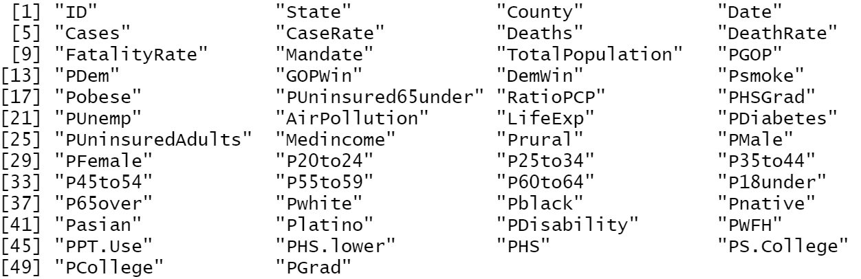
Variable Breakdown
Any more suggestions?

Slide 8

3 Dates of Note
April 01, 2020
October 01, 2020
February 20, 2021
Early pandemic, but still enough time has passed to collect valuable data
Used to see how the virus impacted the starting points in the country
Well into the pandemic
Lockdown/quarantine
The summer season provides a lot of insight
Masking and social distance guidelines have been implemented
Nearly a year into the pandemic → a lot of data has been collected
Major holidays have passed
Vaccination roll out in full swing
How does this effect senior citizens?

Slide 9
Exploratory Data Analysis

Slide 10
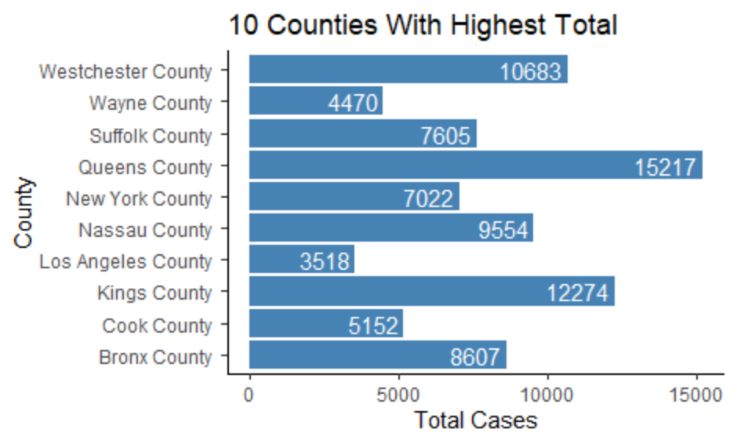
EDA, 04/01/20
Large metro areas were hit the hardest early on
Denser population
More face-to-face interactions
More access to public transport
Places like: New York and the surrounding areas, Los Angeles, Detroit, and Seattle

Slide 11
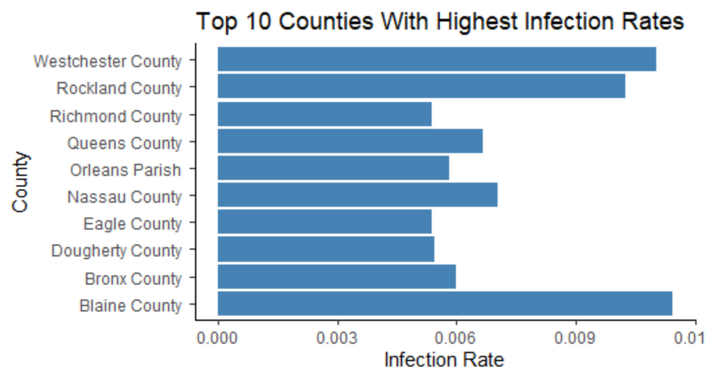
EDA, 04/01/20
Case rate shows some overlap, but we start to see some smaller, more isolated areas have a higher case rate
Eagle County → Colorado
Blaine County → Idaho
Dougherty County → Georgia

Slide 12
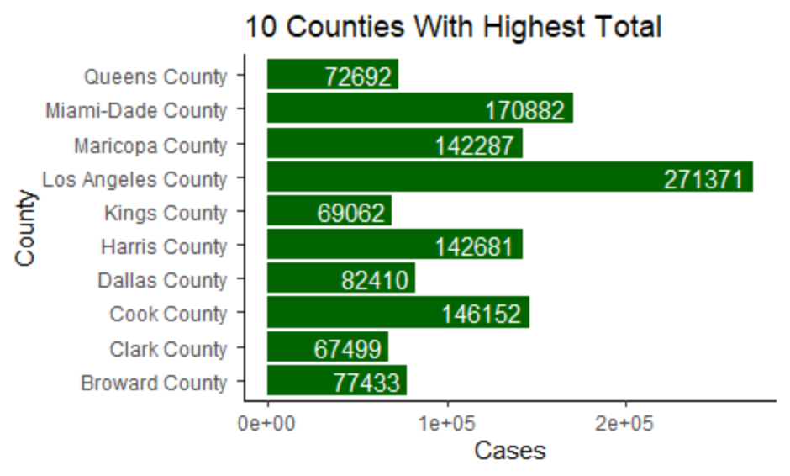
EDA, 10/01/20
Now that the pandemic has been raging for months, we see some of the hardest hit counties with some new players
Florida and Texas → tourist hubs as well as less strict masking/ social distancing guidelines
LA County holding a commanding lead → largest county in the country

Slide 13
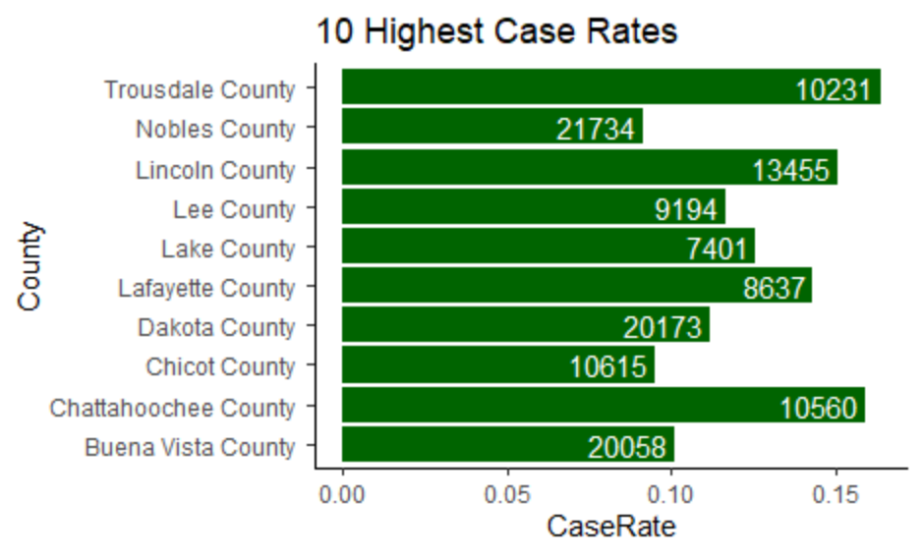
EDA, 10/01/20
White number is the total population of the county
All small, rural counties
TN, MN, GA, NE, IA, etc.
Not a single county over 22,000 people, yet we see such a high percentage of cases
How does the virus spread across such small communities?

Slide 14
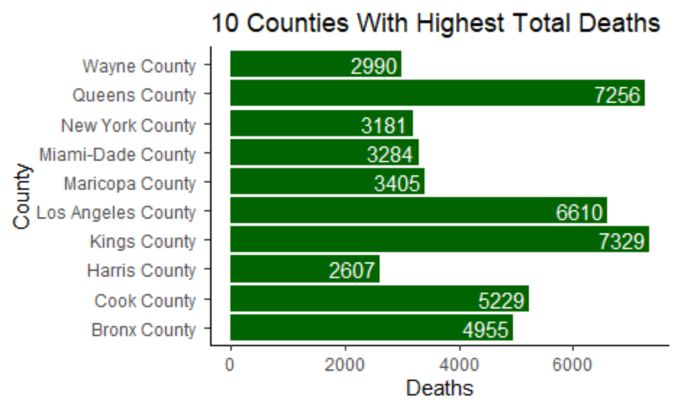
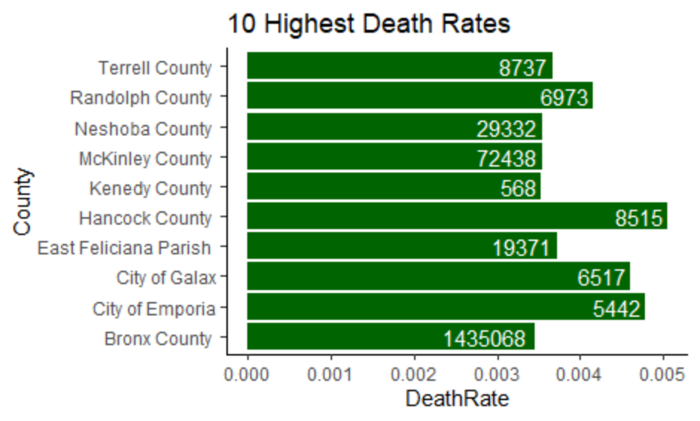
* The white text is # of deaths
* The white text is total population

Slide 15
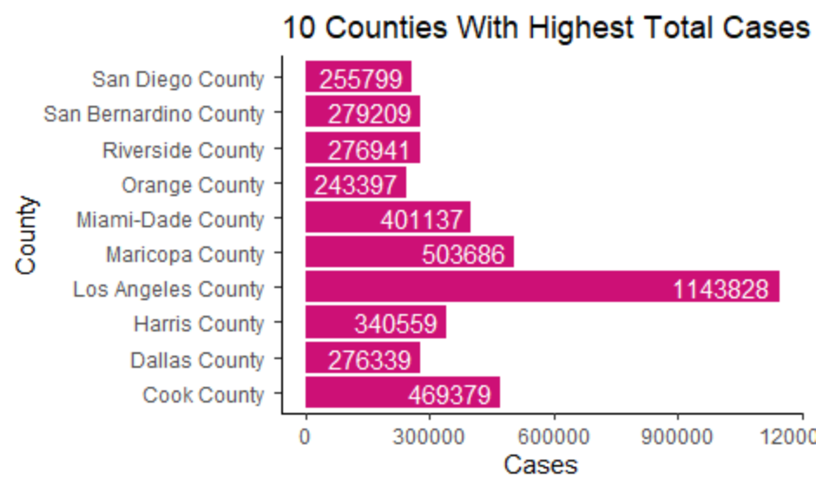
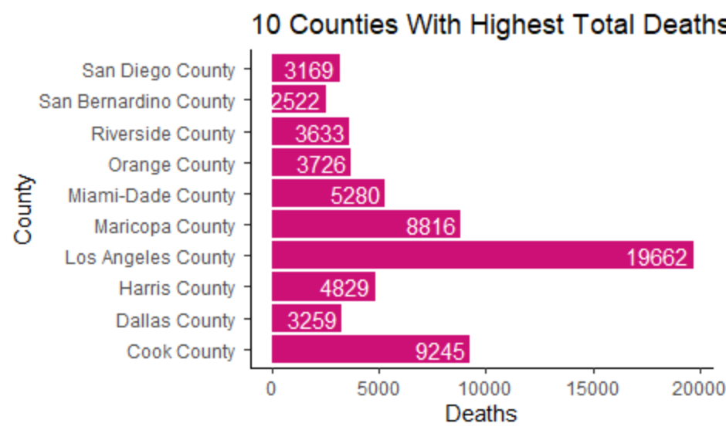
EDA, 02/20/21
After almost a year of collecting data, we see that the larger counties, in terms of population, will yield the largest number of total cases and total deaths
Los Angeles continues to lead the way despite almost a year of strict guidelines

Slide 16
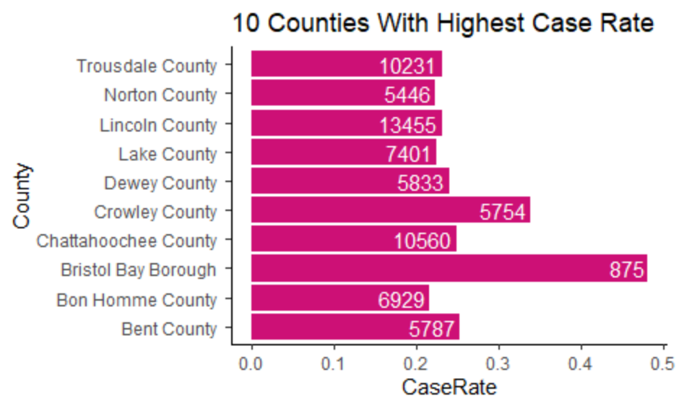
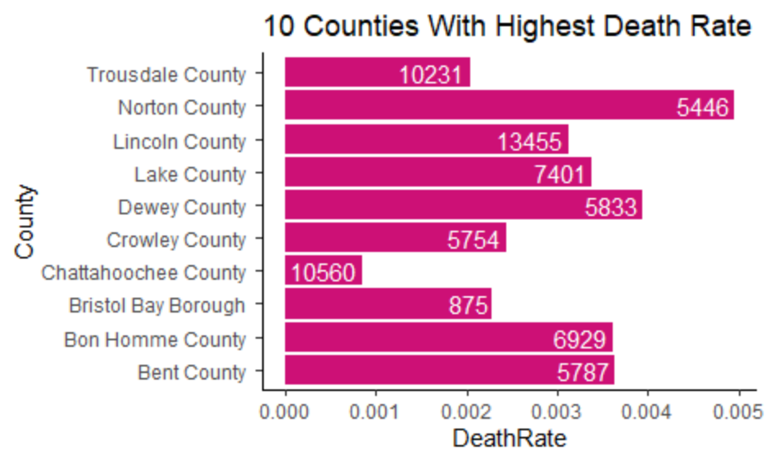
EDA, 02/20/21
When we look at case and death rate, we see that the 10 highest are all small, rural, and isolated areas of the country
Bristol Bay, Alaska: very small territory with a population of just 875 had almost 50% infection rate!
Usually, these small communities are very close knit, where everyone knows each other and interacts with each other daily
Unlike larger counties, the economies of these small counties could really suffer if they were forced to shut down due to the pandemic
* White text in bars = total county population

Slide 17
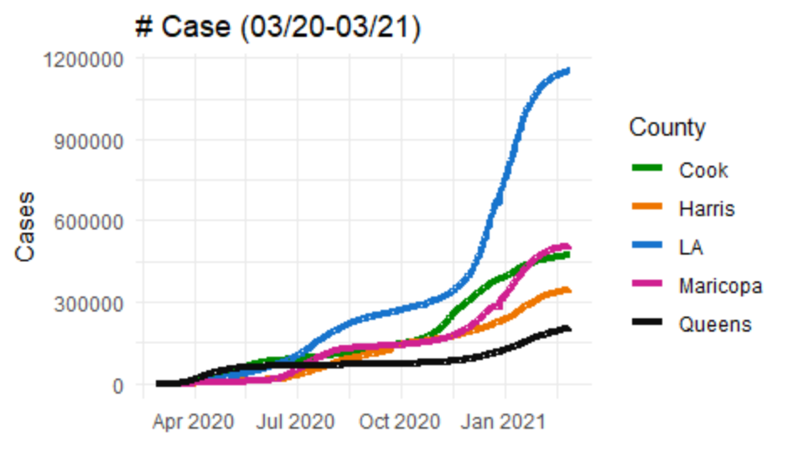

Slide 18
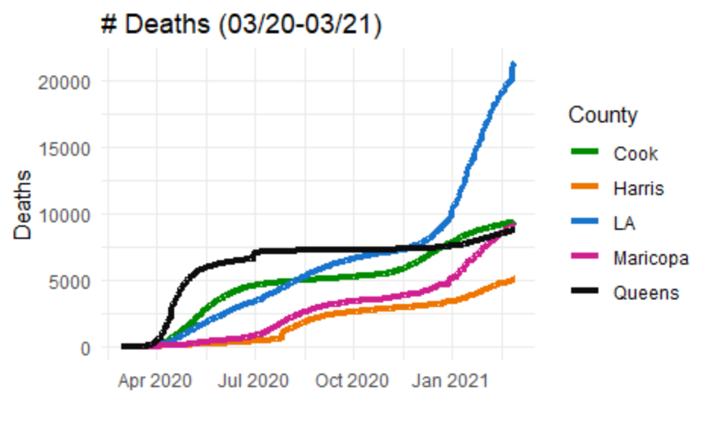

Slide 19
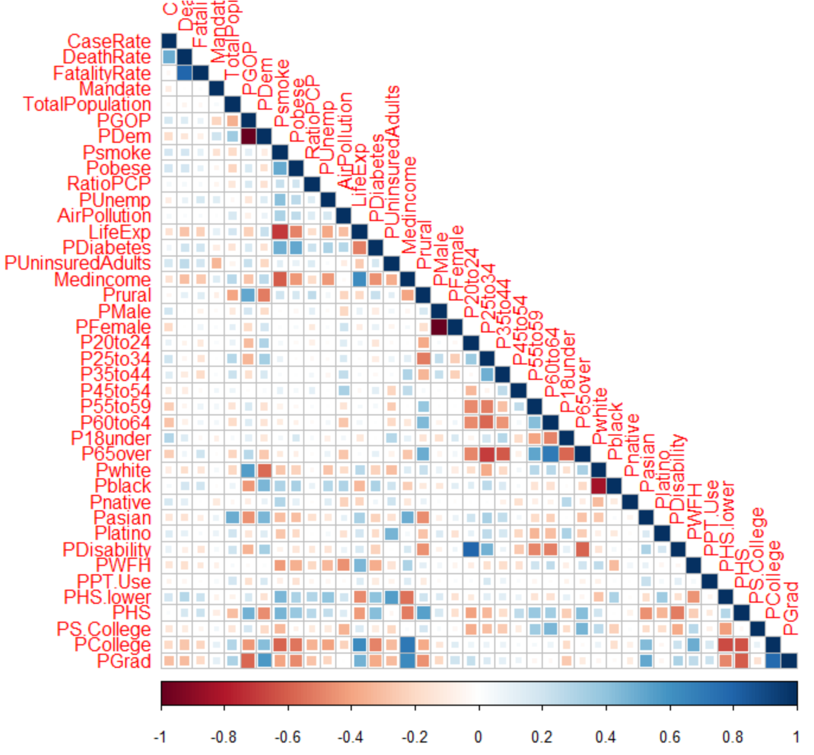
* Note this uses Case Rate and Death Rate as of 02/25/21

Slide 20
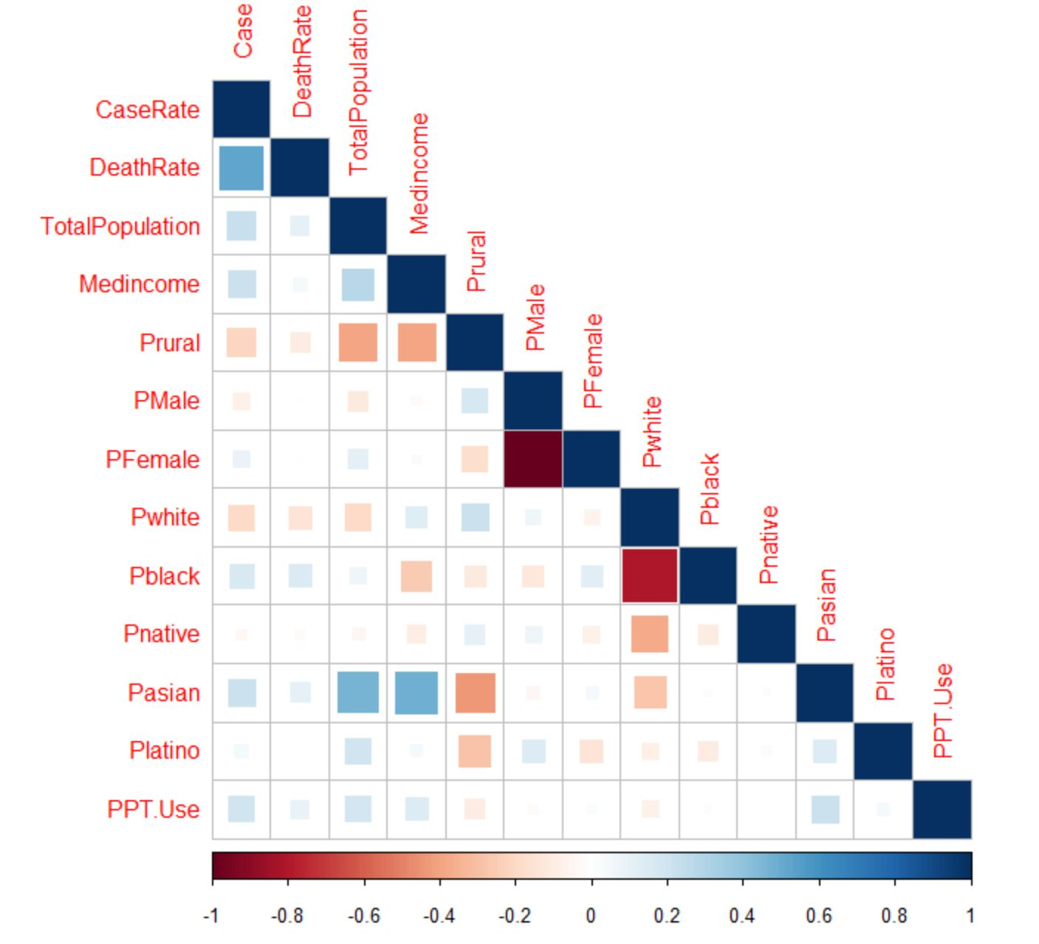
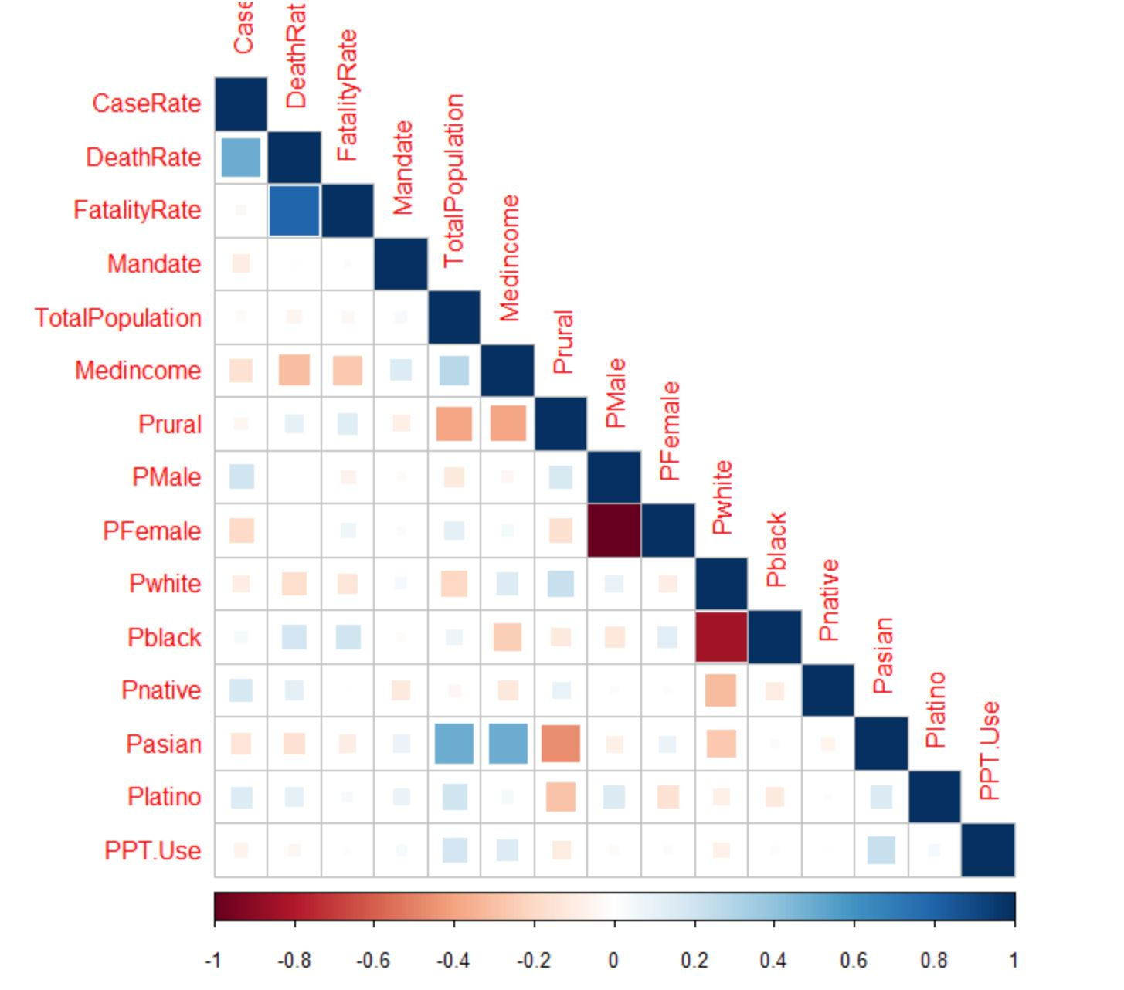
Case and Death Rate 04/01/2020
Case and Death Rate 02/25/2021

Slide 21
Regression

Slide 22
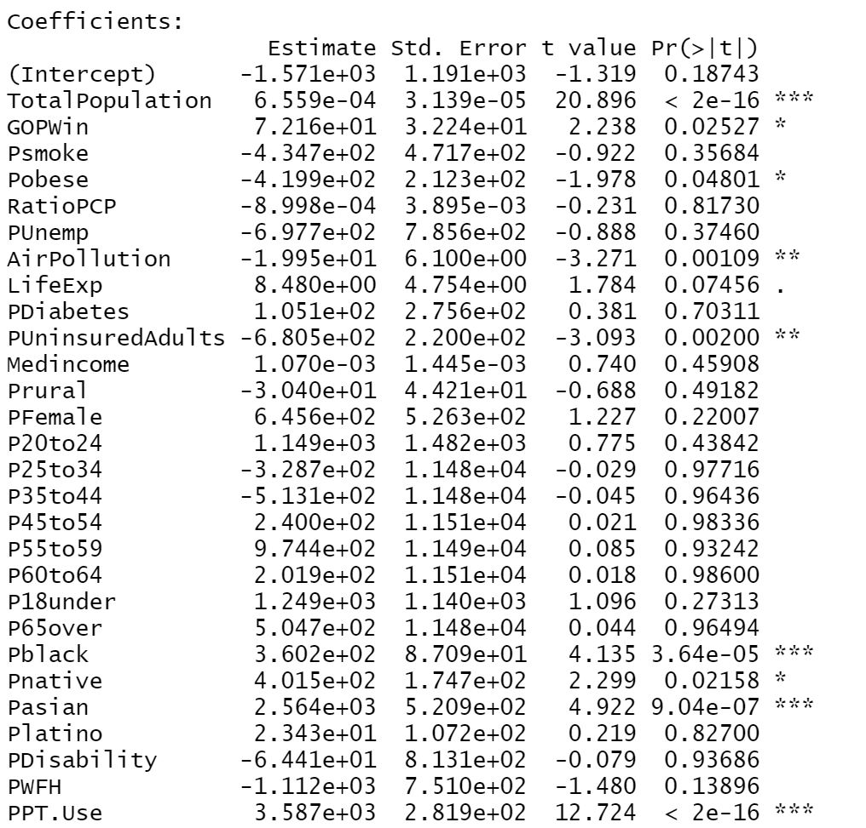
Cases 04/01/20
Adj. R-squared: 0.297
Key Significant Factors:
Counties with higher population
Counties with high public transport usage
Asian and Black communities saw the biggest impact

Slide 23
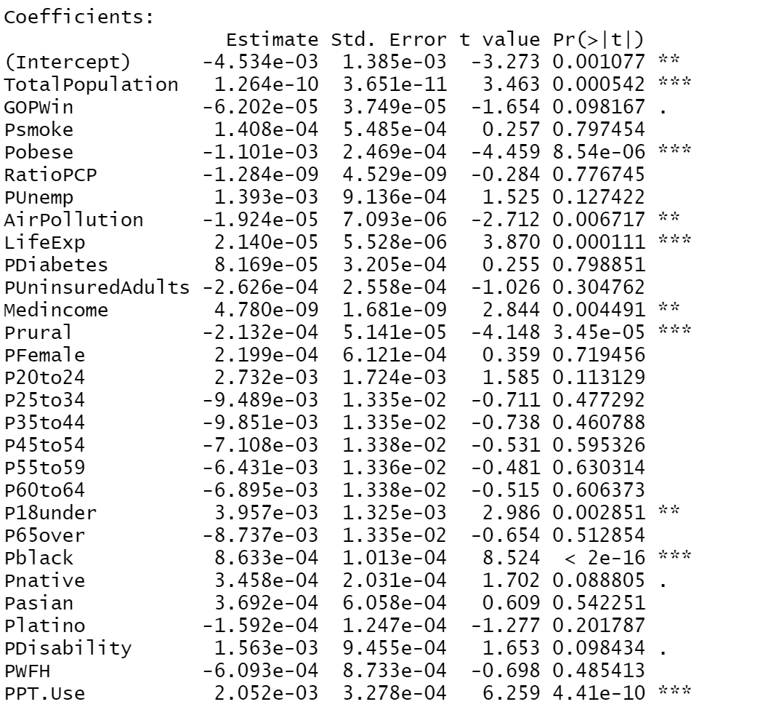
Case Rates 04/01/20
Adj. R-squared: 0.168
Key Significant Factors:
Public transport again is a big factor for predicting case rates in the early stages
Black communities saw the biggest impact
Total Population significant again

Slide 24
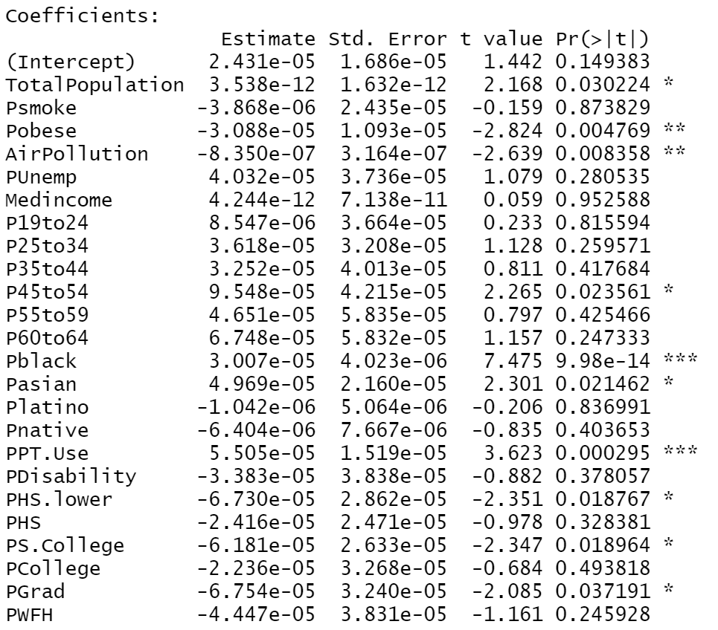
Death Rates 04/01/20
Low Adj. R-squared at ~ 0.05
Higher educated
Public Transport proving to be deadly early on

Slide 25
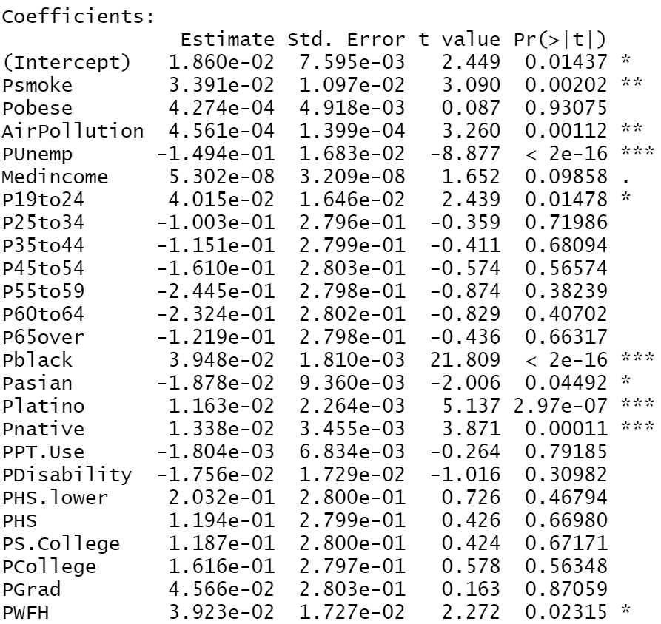
Case Rates 10/01/20
Minority communities all significant
Asian population see less → this is a change from the beginning of the pandemic
Unemployment percentage and counties with higher air pollution

Slide 26
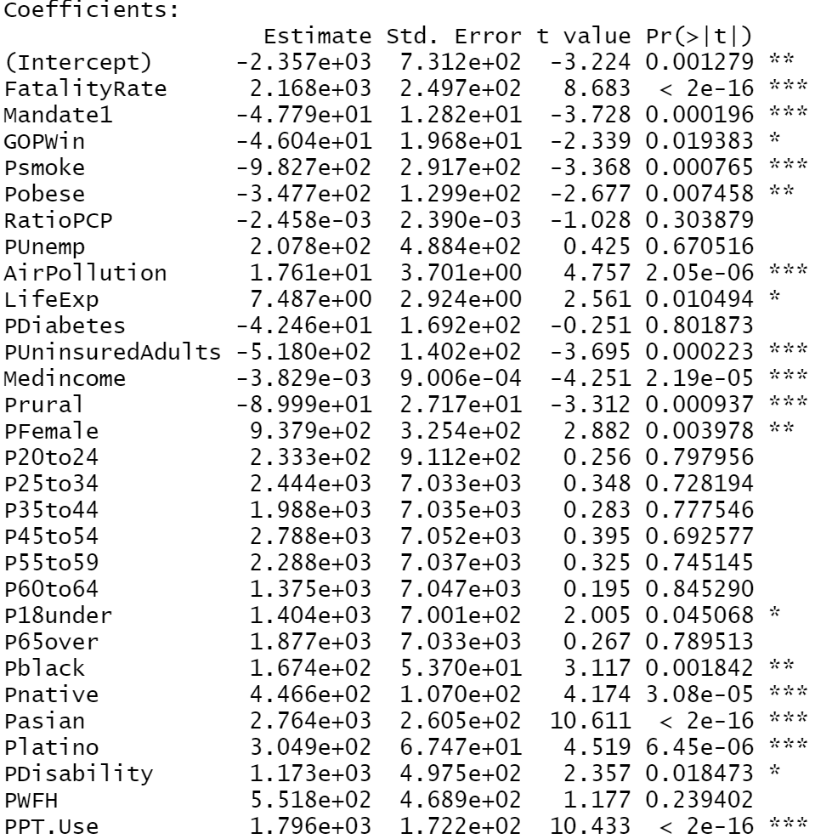
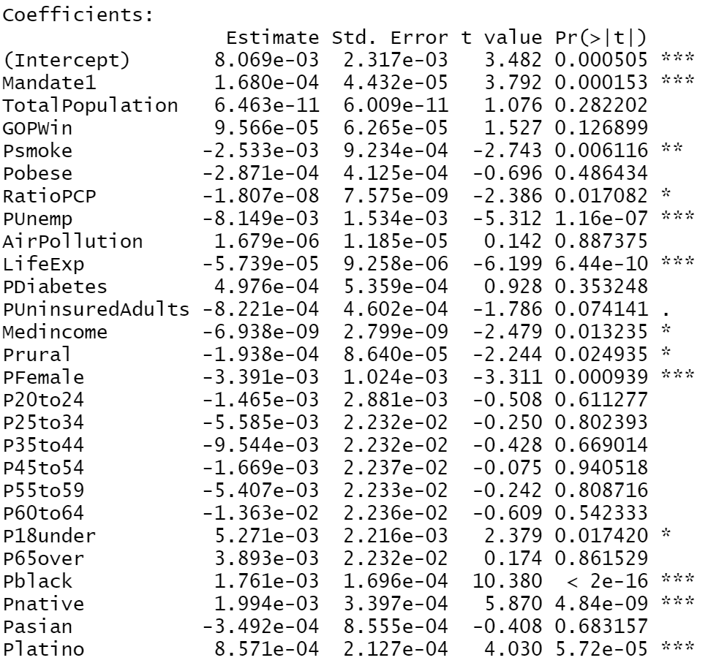
# of Deaths and Death Rates 10/01/20
# of Deaths
Cities with high public transport usage see increased numbers, possibly due to pandemic fatigue
Uninsured adults see less deaths → more cautious
Death Rates
As the pandemic rages on, the black communities still are seeing a disproportionate death rate.
Cities with higher life expectancy see lower rates → access to health care.
# of Deaths Death Rates

Slide 27
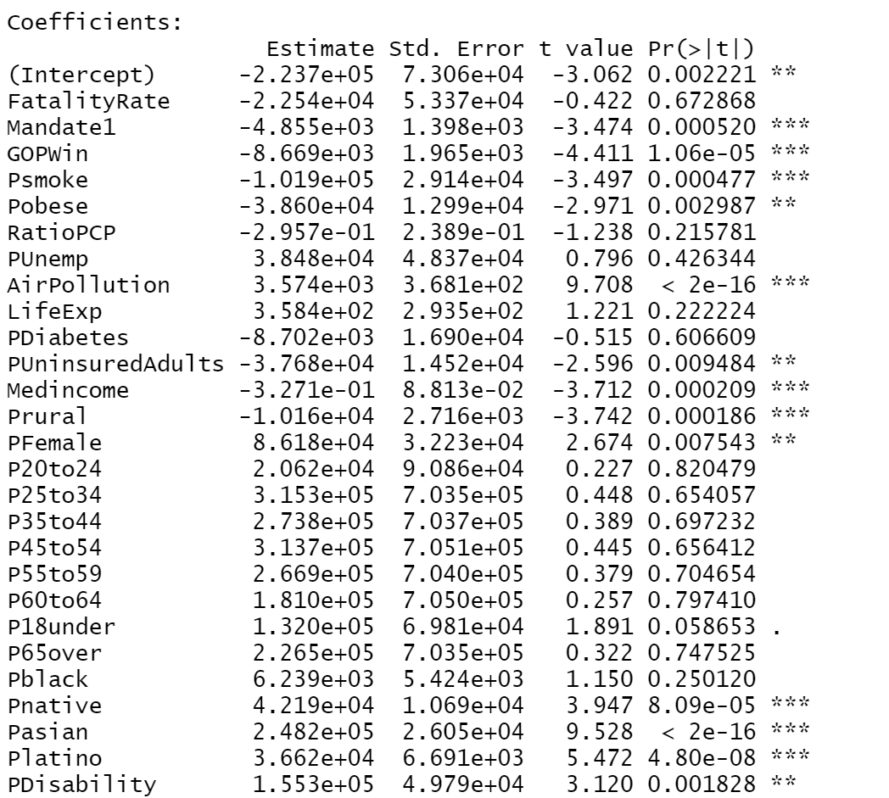
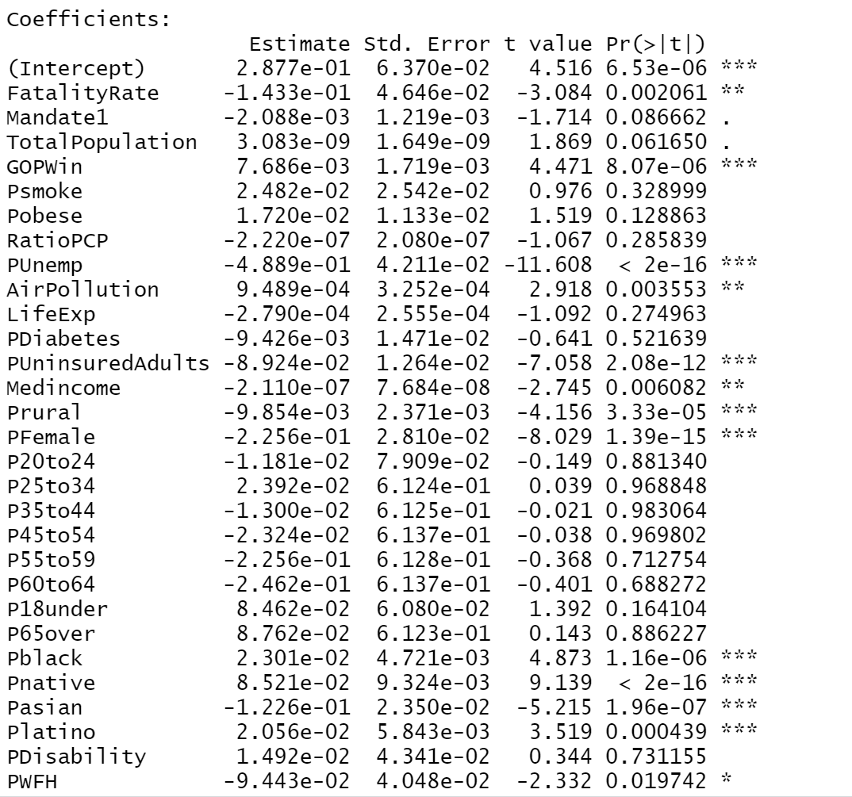
Case and Case Rates 02/25/21
Left Side: Cases
Counties in states with active mask mandates saw lower number of cases!
Right Side: Case Rate
Unemployment rate → people staying home
Counties who voted for Trump saw a higher case rate

Slide 28
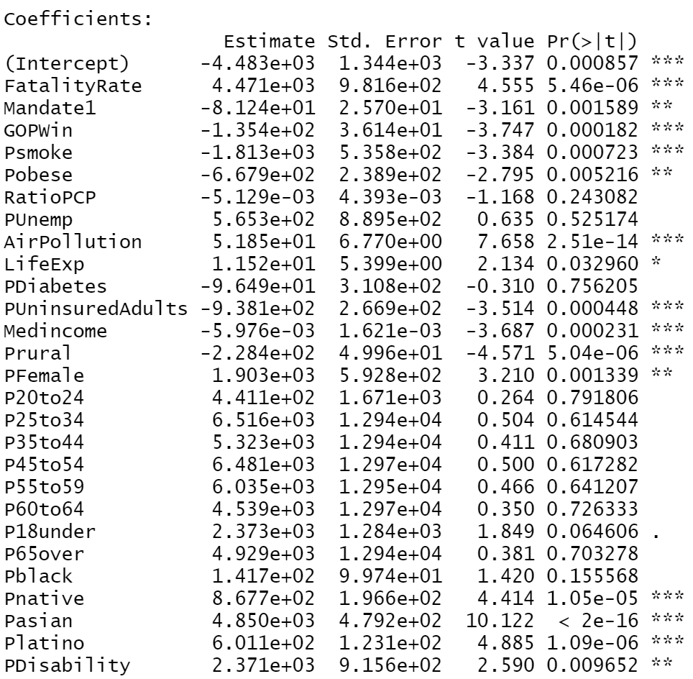
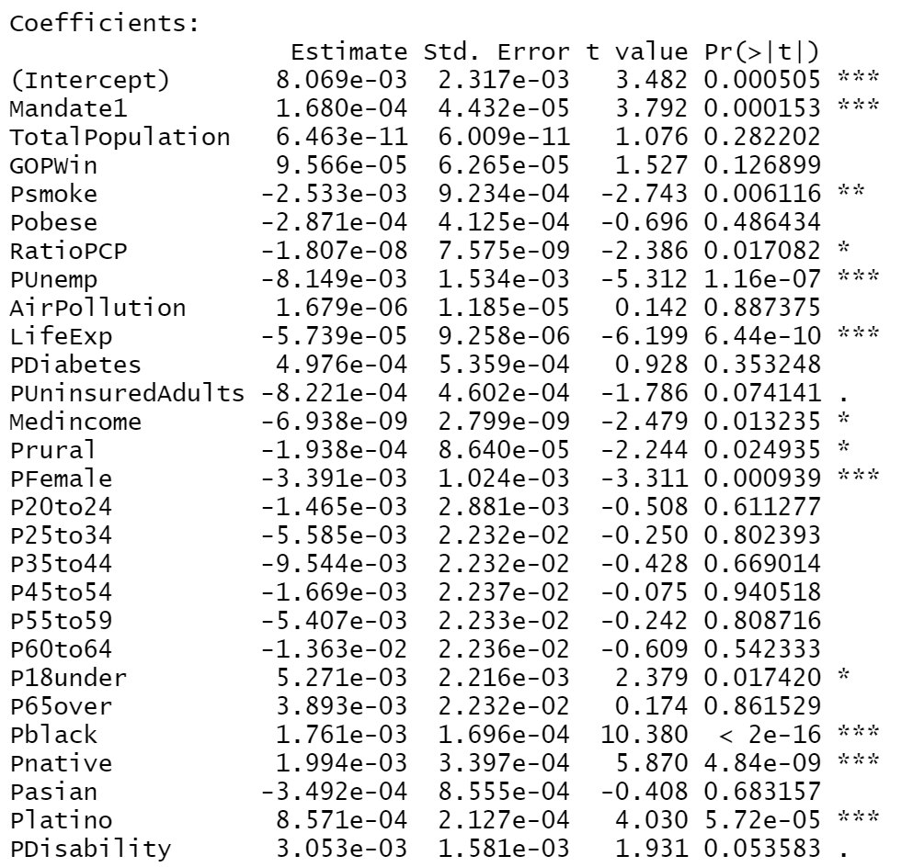
# of Deaths and Death Rates 02/25/21
Left Side: # of Deaths
Masks save lives
GOP counties post-election are significant
Right Side: Death Rates
Black, Native American, and Latino communities see higher death rates
Unemployment rates → again we see people staying home lead to a lower death rate

Slide 29
Identifying the Best Variables
Using the “Regsubsets” function to pick out the best predictors for case rates and death rates

Slide 30
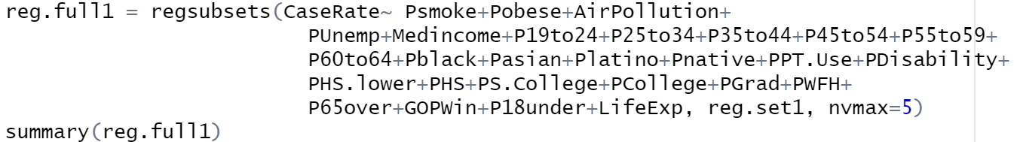
Identifying the Best Variables
The process is very similar to linear regression in R
Identify the variables you want to consider and the function will output the most important ones
I chose nvmax = 5, which outputs the 5 most important variables

Slide 31
Identifying the Best Variables → Case Rates
04/01/2020
10/01/2020
02/20/2021
Median income
Percentage of population that is Black
Public transportation usage
Obesity Rate
Education rate → percentage of population with out a college degree
Percentage of population that is Black
Percentage of population age 60-64
Education rate → percentage of population without a HS degree
Percentage of population age 55-59
Unemployment rate
Education rate → percentage of population with higher degree (graduate)
Percentage of population age 60-64
Unemployment rate
Percentage of population age 55-59
Percentage of population that is Black

Slide 32
Identifying the Best Variables → Death Rates
04/01/2020
10/01/2020
02/20/2021
Percentage of the population that is Black
Percentage of the population that is Asian
Public transportation usage
Obesity Rate
Percentage of population age 45-54
Percentage of the population that is Black
Percentage of the population that is Latino
Education rate → percentage of population without a college degree
Percentage of population age 65+
Percentage of population under 18
Education rate → percentage of population with higher degree (graduate)
Percentage of the population that is Black
Percentage of population age 65+
Percentage of population under 18
Education rate → percentage of population without a college degree

Slide 33
Geographical Visualizations
Seeing the spread

Slide 34
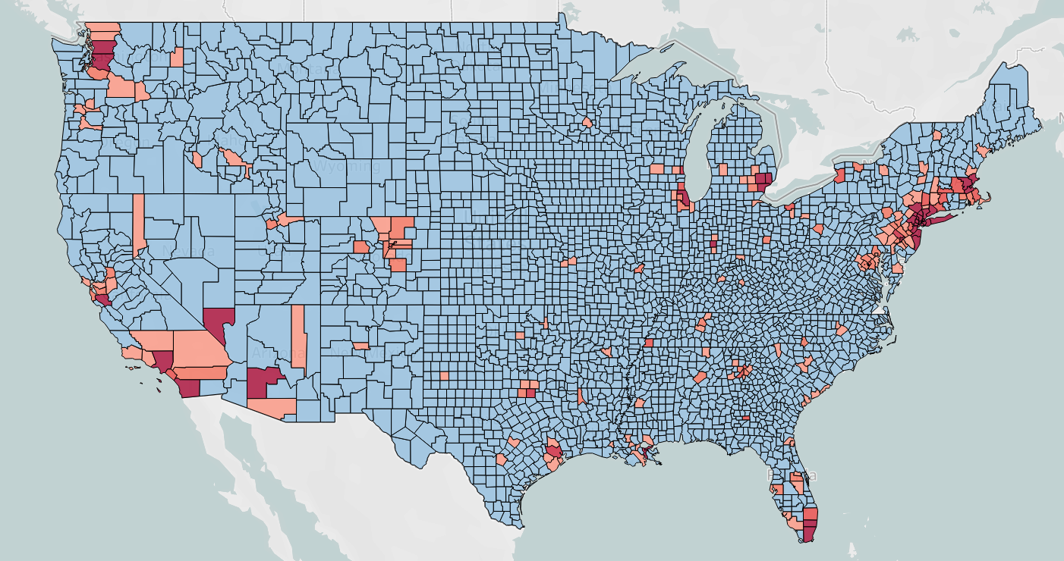
*Made in Tableau
Color Scale:
Blue:
0-100
Light Red:
100-1000
Dark Red:
1000+
New York
Los Angeles
Miami
Case Totals as of 04/01/2020
Highly populated and costal areas hit the hardest → places like LA, New York and Miami
Midwest not seeing the effects just yet

Slide 35
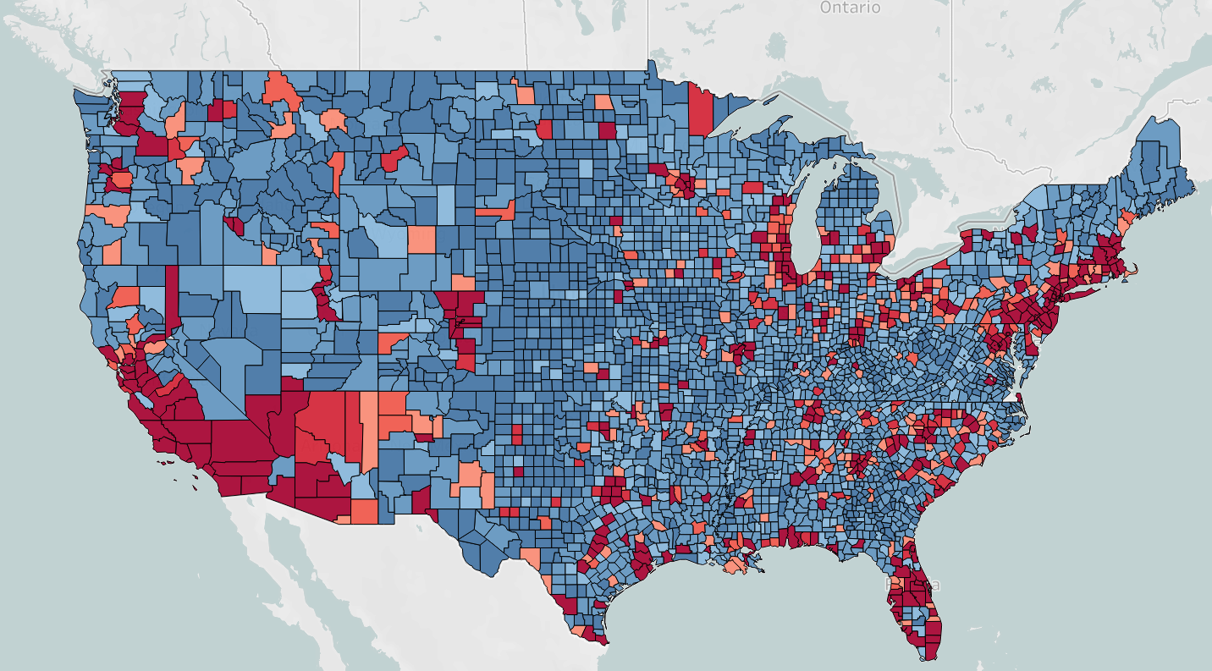
* Made in Tableau
Color Scale:
Dark Blue:
0-1,000
Light Blue:
1,000-7,500
Light Red-Orange:
7,500-20,000
Red:
20,000+
Case Totals as of 02/20/2021
Every corner of the US has now seen a significant spike in cases
No longer isolated to costal areas and major cities, although they are seeing the worst of it

Slide 36
Conclusions
As the pandemic evolved, we saw different factors influence it at different times
Counties with higher population, predictably, saw more cases, but the counties with higher infection rates were smaller, more rural counties
Some of the major factors include: racial demographics, access to quality health care, income, public transportation usage, MASKS, social isolation, and more
Some of these factors can, in fact, be pinpointed down to the county level
What can we do to crush the current pandemic and prevent future ones? → Invest in minority communities, provide easier and safer access to health care, improve health education, and once again… masking and social distancing

Slide 37
Fin
Thanks for watching!
Questions?

Slide 38
Sources
https://usafacts.org/visualizations/coronavirus-covid-19-spread-map/
https://opportunityinsights.org/data/
U.S. Census Bureau
American Community 5-Year Survey, 2019
https://data.census.gov/cedsci/
Graphs/tables/maps → made either in R or Tableau
Other pictures sourced from clip art

